Slide 1
Enterprise Network Design for Multi-National Company

Slide 2
Business Overview
Goal: Reliable, scalable & secure enterprise connectivity
Supports branch offices, data center, and cloud apps

Slide 3
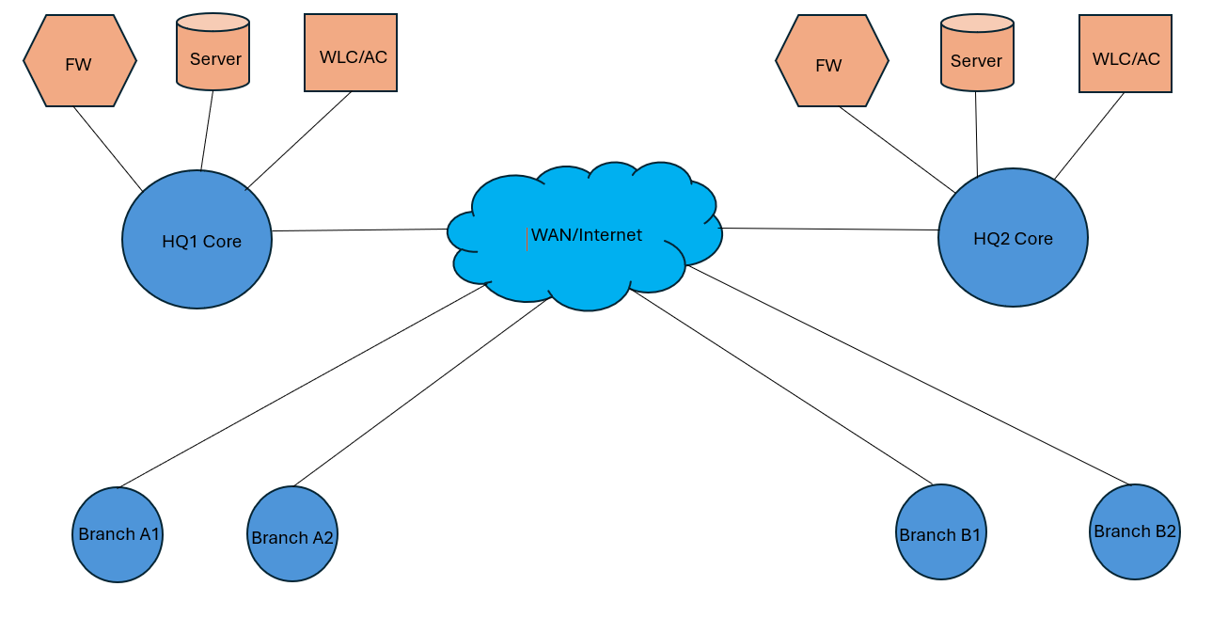
Diagram

Slide 4
The proposed architecture integrates two primary Headquarters (HQ1 in Egypt and HQ2 in Saudi Arabia) with multiple branch offices, all interconnected via secure links to ensure efficient data exchange and communication. The goal of this project is to design a scalable, secure, and highly available enterprise network capable of supporting multiple branches, centralized services, and external connectivity through multiple ISPs.
HQ1 & HQ2: Core network infrastructure, centralized services.
Branch Offices: Local network access.
Wireless Access: Secure Wi-Fi deployment for user mobility.

Slide 5
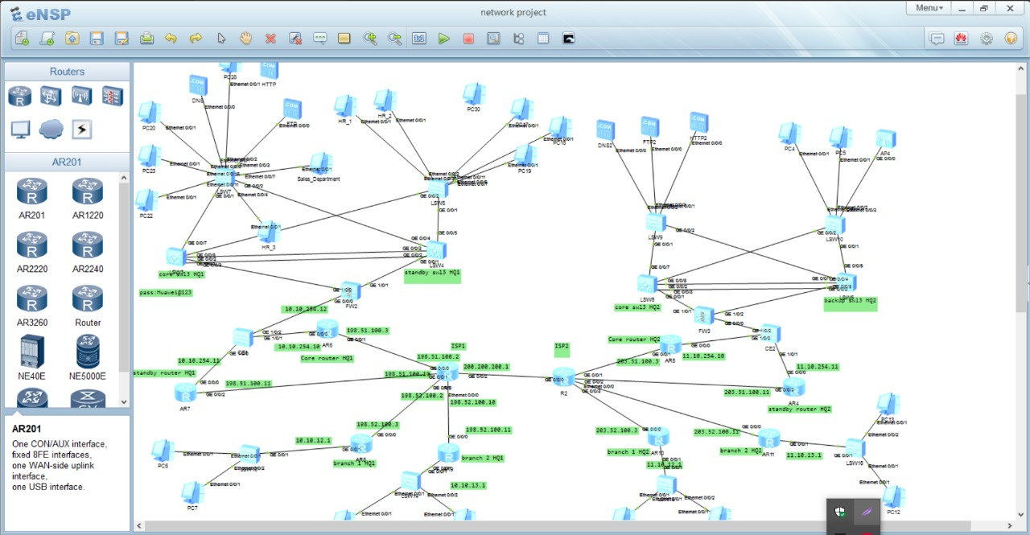
Topology

Slide 6
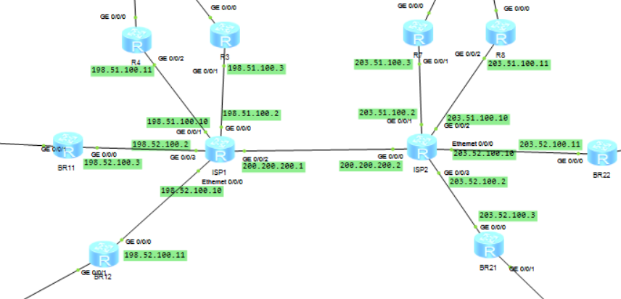
1. ISP Edge & External Connectivity (BGP Domain)

Slide 7
The ISP edge is built for high availability. Two redundant edge routers peer with dual ISPs using BGP, ensuring uninterrupted Internet access.
Dual ISPs for redundancy and traffic engineering. Each HQ pair peers with the local ISP via BGP.
Each ISP advertises default route; ISPs receive default-route-advertise from each HQ peer (in your ISP configs).
BGP sessions with prefix filtering to prevent route leaks.
Failover and load-balancing configured to guarantee service continuity.
This provides a strong external backbone for cloud access, remote branches, and public-facing services.

Slide 8
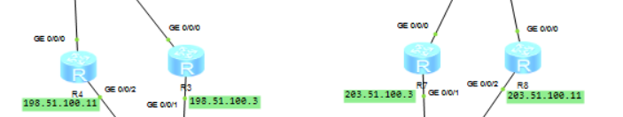
VRRP & High Availability (Active / Standby pairs)
VRRP provides gateway redundancy for each site: VIP (10.10.254.5 for HQ1) is used by hosts.
Higher priority on active device ensures preferred master; preempt-mode enabled to allow preferred router to regain master role after recovery.

Slide 9
OSPF design — internal routing (HQs & branches)
OSPF process 1 area 0.0.0.0 used as backbone for all internal connectivity.
Loopbacks advertise as host routes (used for router-IDs and reachability).
OSPF is also used as the source of routes that are imported into BGP (import-route bgp in OSPF stanza or import-route ospf 1 in BGP stanza, depending on device type), enabling internal prefixes to reach the Internet via BGP.
route redistribution both ways (BGP->OSPF, OSPF->BGP) and control with route filters to avoid loops.

Slide 10
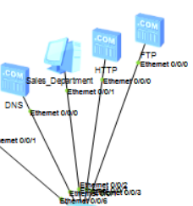
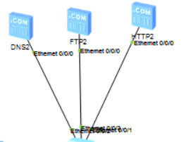
Server Farm / DMZ / Data Center segment
Multi server & Services: DNS, HTTP, & FTP.
Firewall enforces north-south and east-west policies.
Core router provides L3 gateway and route distribution for server subnets.

Slide 11
Security & AAA (device management, SSH, TACACS/AAA)
Centralized local-user config (your configs use local-user admin with cipher password) for production, replace local accounts with TACACS+/RADIUS.
Use SSH (telnet on Huawei) and disable insecure protocols.
Restrict vty access to AAA and limit privilege levels.

Slide 12
VLAN Architecture and Segmentation
Egypt Headquarters (Country A) VLANs:
VLAN 10: Server/Infrastructure (10.10.10.0/24)
VLAN 11: User Devices/Workstations (10.10.11.0/24)
VLAN 12: Branch 1 Network (10.10.12.0/24)
VLAN 13: Branch 2 Network (10.10.13.0/24)
VLAN 252: Management (Firewall Link) (10.10.252.0/24)
VLAN 253: Management (Firewall Link) (10.10.253.0/24)
VLAN 254: Core Infrastructure (10.10.254.0/24)
Gulf Headquarters (Country B) VLANs:
VLAN 11.11.10.0/24: Server/Infrastructure
VLAN 11.10.11.0/24: User Devices/Workstations
VLAN 11.10.12.0/24: Branch 1 Network
VLAN 11.10.13.0/24: Branch 2 Network
VLAN 11.10.252.0/24: Management (Firewall Link)
VLAN 11.10.253.0/24: Management (Firewall Link)
VLAN 11.10.254.0/24: Core Infrastructure

Slide 13
Monitoring & NOC (visibility, logging, alarms)
SNMP (Simple Network Management Protocol):
Enable SNMP v3 on all network devices for secure monitoring
Community string: Private (for SNMPv2c during transition)
Trap destinations: Central NOC syslog server
NetFlow/sFlow:
Enable on core routers and switches for traffic analysis
Flow export to centralized analytics platform
5-tuple flow export for application behavior analysis
Syslog Aggregation:
Centralize all device logs to syslog server
Configure severity levels: Emergency, Alert, Critical, Error, Warning, Notice, Info, Debug
Archive logs for compliance and forensic analysis

